Slide 1
Predictive Modeling
Chapter 5: Measuring Performance in Regression Models
STA 6543
The University of Texas at San Antonio

Slide 2
Outline
Quantitative measures of performance
The mean absolute error (MAE)
The mean squared error (MSE)
The root mean squared error (RMSE)
The coefficient of determination (R²)
The bias-variance trade-off
Training MSE vs. Test MSE

Slide 3
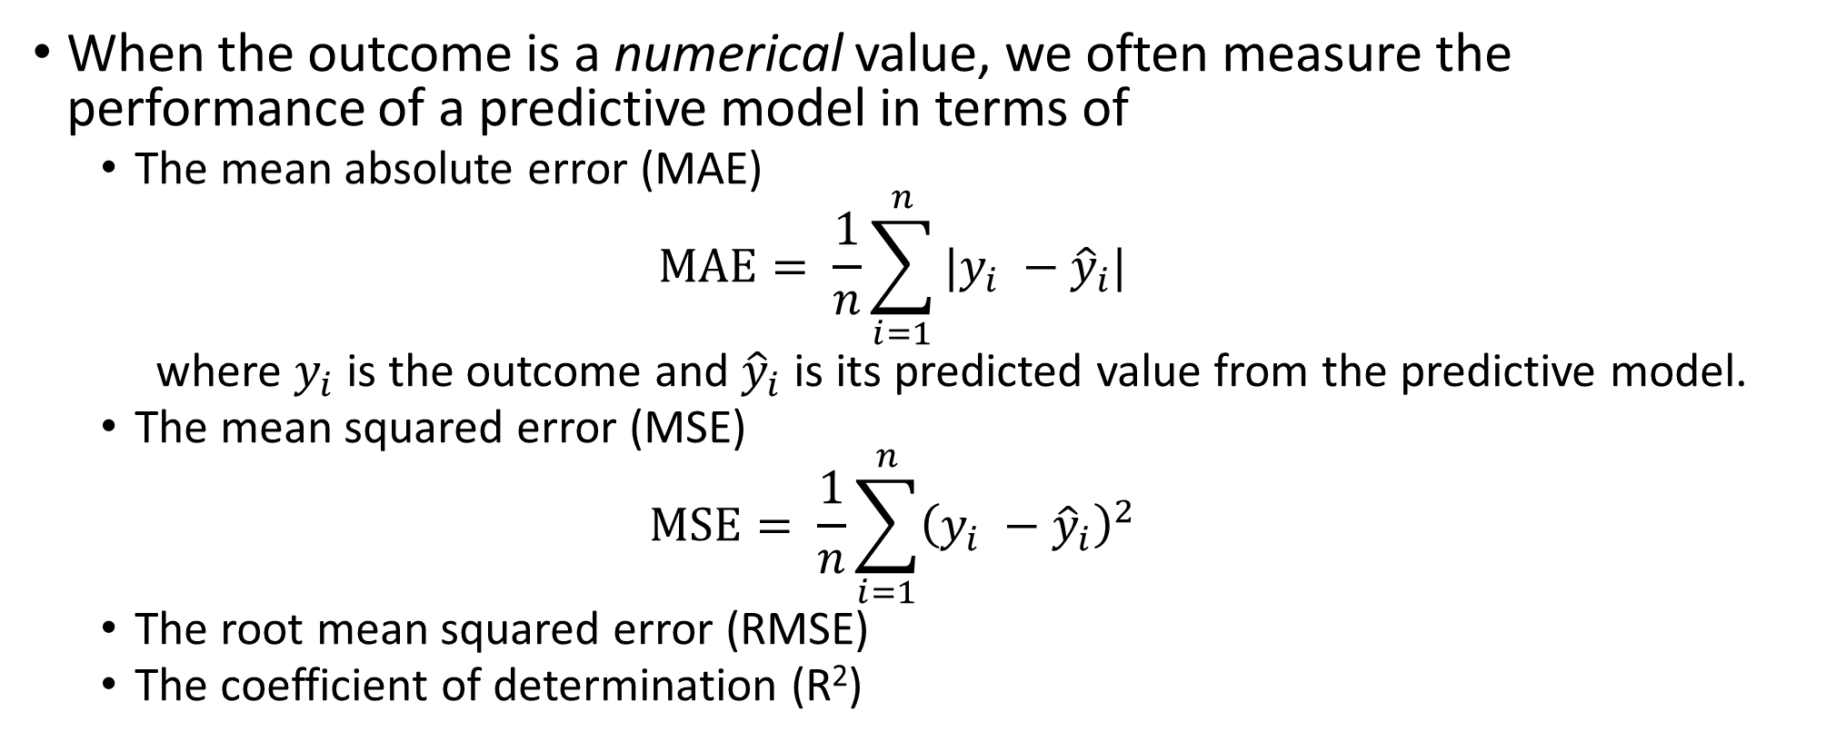
Quantitative measures of performance
When the outcome is a numerical value, we often measure the performance of a predictive model in terms of
The mean absolute error (MAE)
$$MAE= \frac{1}{n}\sum_{i=1}^{n}{|y_{i} −{\hat{y}}_{i}|}$$
where $y_{i}$ is the outcome and ${\hat{y}}_{i}$is its predicted value from the predictive model.
The mean squared error (MSE)
$$MSE= \frac{1}{n}\sum_{i=1}^{n}{{\left(y_{i} −{\hat{y}}_{i}\right)}^{2}}$$
The root mean squared error (RMSE)
The coefficient of determination (R²)

Slide 4
Quantitative measures of performance
#install.packages('Metrics') library(Metrics) # Use the 'c' function to combine numbers into a vector y <- c(0.22, 0.83, -0.12, 0.89, -0.23, -1.30, -0.15, -1.4, 0.62, 0.99, -0.18, 0.32, 0.34, -0.30, 0.04, -0.87, 0.55, -1.30, -1.15, 0.20) #observed yhat <- c(0.24, 0.78, -0.66, 0.53, 0.70, -0.75, -0.41, -0.43, 0.49, 0.79, -1.19, 0.06, 0.75, -0.07, 0.43, -0.42, -0.25, -0.64, -1.26, -0.07) #predicted

Slide 5
Visualize the results
#Visualize the results diff <- y - yhat #plot of the observed and predicted values plot(y, yhat) fit = lm(yhat~y) abline(fit) #plot of the predicted values and residuals residual = resid(fit) plot(yhat, residual, col=2) abline(h = 0, col = "darkgrey", lty = 2, lwd=2)

Slide 6
Visualize the results

Slide 7
#MAE mae(y, yhat) #or mean(abs(y - yhat)) #MSE (MSE = mean((y - yhat)^2)) #RMSE sqrt(MSE) #or RMSE(y, yhat) #R^2 cor(y, yhat)^2 #or R2(y, yhat)

Slide 8
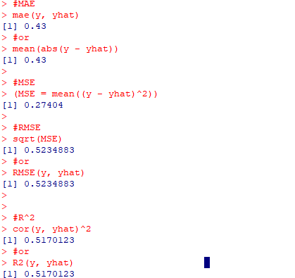
R results
MAE and RMSE — Which Metric is Better? https://medium.com/human-in-a-machine-world/mae-and-rmse-which-metric-is-better-e60ac3bde13d

Slide 9
The bias-variance trade-off
If we assume that the data are statistically independent and that the residuals have a theoretical mean of zero and a constant variance of σ², then
σ² is usually called “irreducible noise” and cannot be eliminated by modeling.
$$E\left(MSE\right)= σ^{2}+ {\left(Model Bias\right)}^{2}+Model Variance$$

Slide 10
The bias-variance trade-off
Bias refers to the error that is introduced by modeling a real-life problem (that is usually extremely complicated) by a much simpler problem.
For example, linear regression assumes that there is a linear relationship between Y and X. It is unlikely that, in real life, the relationship is exactly linear so some bias will be present.
The more flexible/complex a method is the less bias it will generally have.

Slide 11
The variance-bias trade-off
Variance refers to how much your estimate for the predictive model would change by if you had a different training data set.
If method has high variance, then small changes in the training data can result in large changes in the estimated model.
Generally, the more flexible a method is, the more variance it has

Slide 12
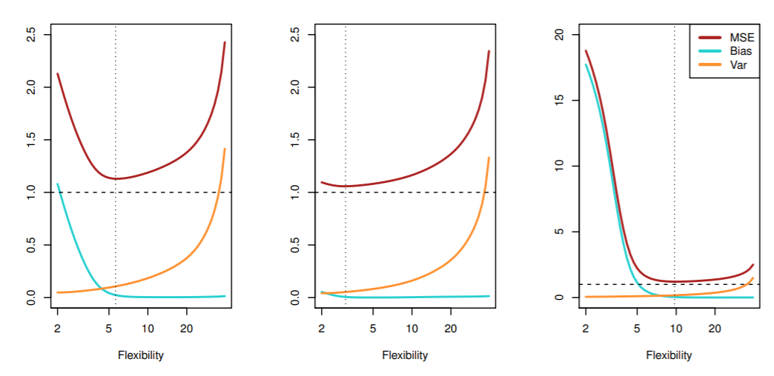
Three examples for the bias-variance trade-off

Slide 13
The bias-variance trade-off
The trade-off means that as a predictive model gets more flexible, the bias will decrease, and the variance will increase but expected test MSE may go up or down.

Slide 14
Training MSE vs. Test MSE
In general, the more flexible (i.e., more model parameters) a method is, the lower its training MSE (apparent error)will be, that is, it will fit or explain the training data very well.
However, the test MSE may in fact be higher for a more flexible method than for a simple approach like linear regression.
Recall: More flexible methods can generate a wider range of possible models as compared to less flexible and more restrictive methods (such as linear regression). The less flexible the method, the easier to interpret the model. Thus, there is a trade-off between flexibility and model interpretability.

Slide 15
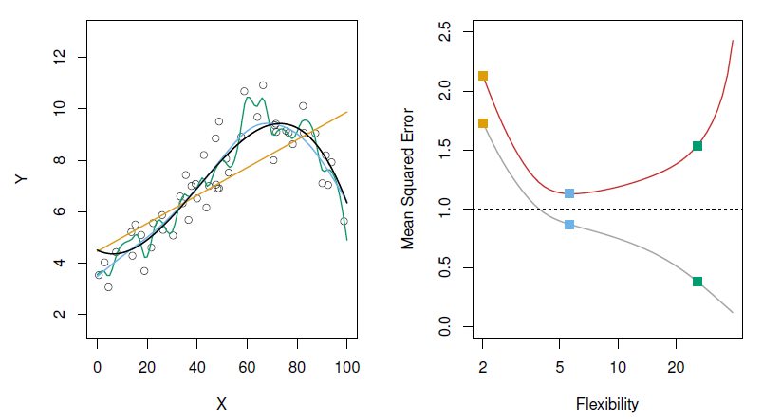
An illustrative example
LEFT: Black—truth. Orange—linear fit. Blue—smoothing spline. Green—smoothing spline (higher level flexibility).
RIGHT: Red—test MSE. Grey—training MSE. Dashed—minimum possible test MSE (irreducible error).

Slide 16
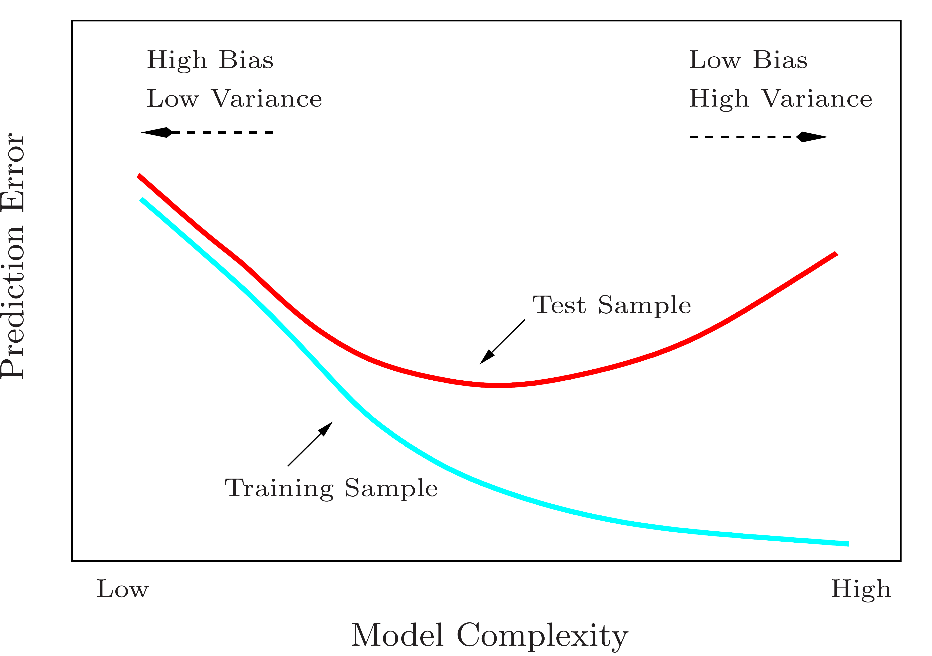
A fundamental picture
Training errors will always decline in general.
However, test errors will decline at first (as reductions in bias dominate) but will then start to increase again (as increases in variance dominate).
Keep this picture in mind when choosing a learning method. More flexible/complicated is not always better.

